Slide 1

CSC3170 PROJECT Football Database of a Professional Football Consulting Company
118010220 HAOTIAN MA (马浩天)
118010224 YU MAO (毛宇)
118010335 Wei WU (吴畏)
118010416 SHIQI Zhang (张诗琪)

Slide 2
CONTENT
1. Project Background
4. Data Analysis
3. Database website performing daily operation queries
2. Database construction
5. Create index on attributes

Slide 3
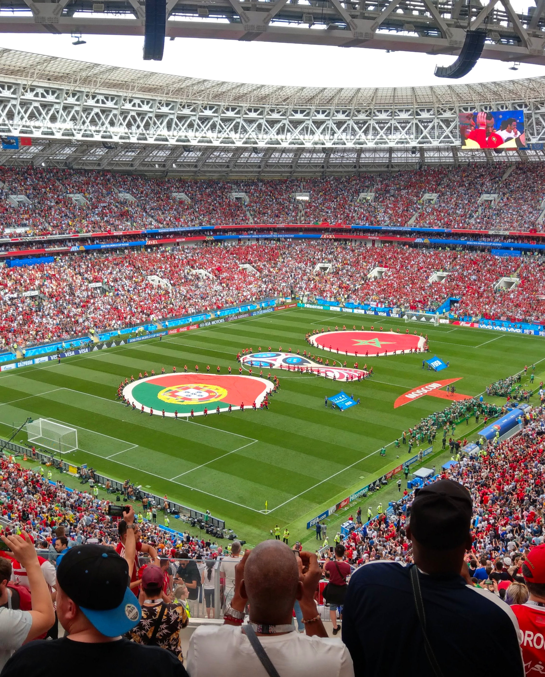
1. Project Background
Goal of the project
Database background and working environment of the project

Slide 4
1. Project Background
1.1 Goal of the project
To design and implement a database that can help achieve the business goals of a professional football consulting company that provides decision support for clubs and players.
This database should store both latest and historical information of players, clubs, and leagues. This database should also support a set of daily operations such as adding, updating, and deleting a player and/or a club.

Slide 5
1. Project Background
DB system:
MySQL 8.0 + MySQL Workbench 8.0
1.2 Working Environment:
2) Website
The website requires Python environment:
Flask_SQLAlchemy==2.4.3
Flask_Login==0.5.0
flask_bootstrap==3.3.7.1
Python >= 3.7
Werkzeug==1.0.1
Flask_Excel==0.0.7
SQLAlchemy==1.3.24
Flask_Mail==0.9.1
WTForms==2.3.1
Flask_WTF==0.14.3
XlsxWriter==1.2.7
PyMySQL==0.9.2
Flask==1.1.2
You can refer to \FIFADB\Website\requirements.txt

Slide 6

2. Database construction
Database design
Database implementation

Slide 7
2.1 Database design

Slide 8
2.1.a construct ERD
The program initially divided the raw data into four entities:
“player”: the information about the players
“club”: the information about the club
“league”: the information about the league
“country_region”: the information about the country or region
Those four tables are connected with 5 relationship sets

Slide 9
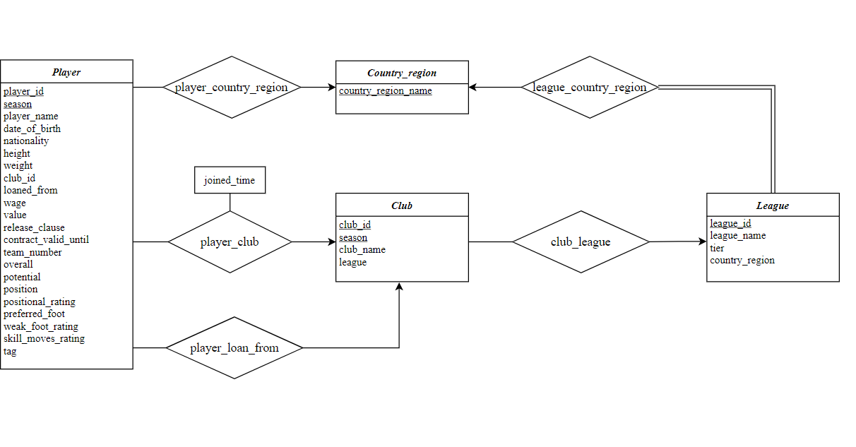
2.1.a construct ERD
Player
Country_region
Club
League

Slide 10
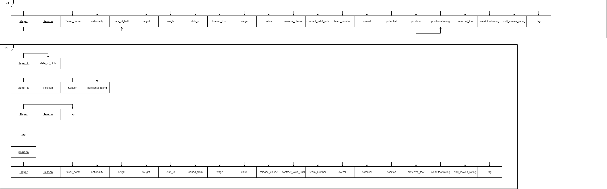
2.1.b normalization

Slide 11
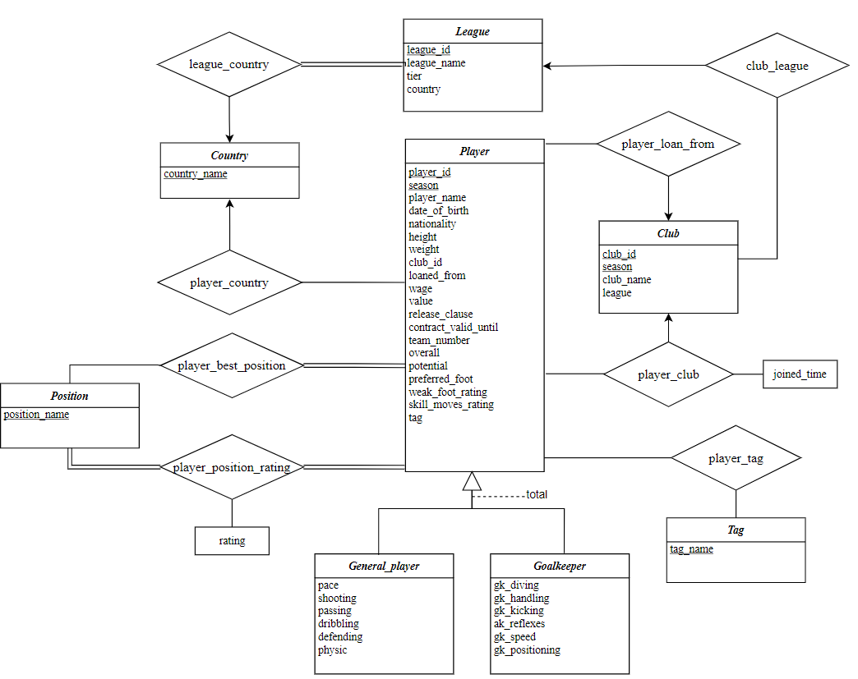
2.1.c normalization
Normalized ERD

Slide 12
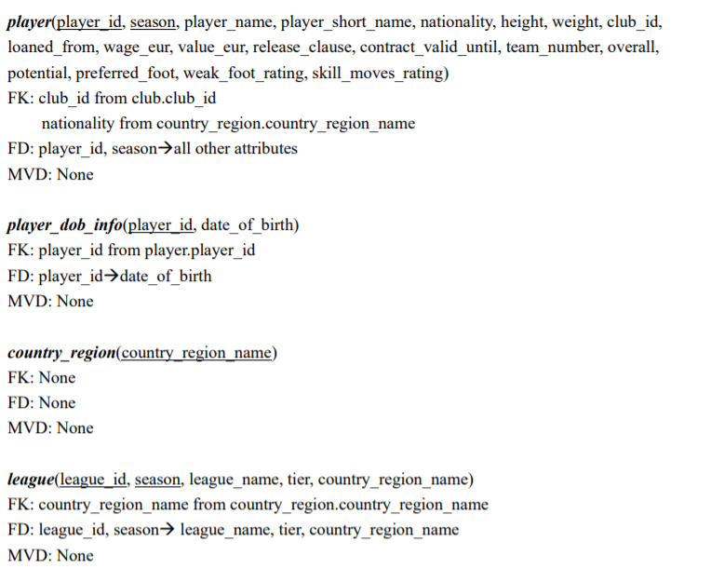
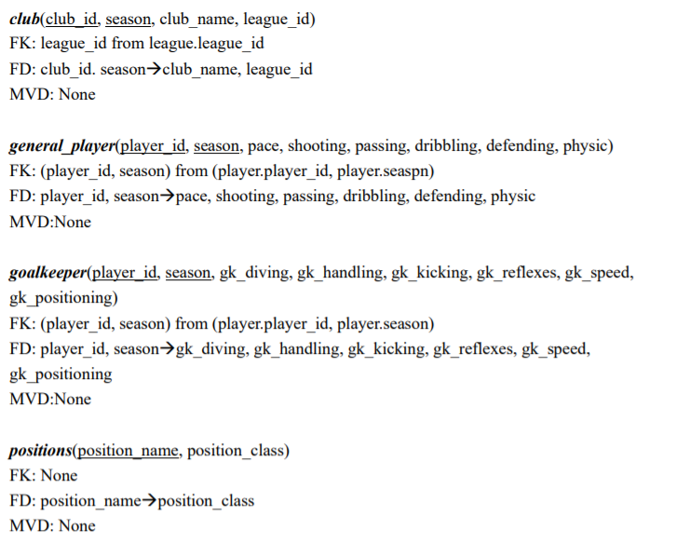
2.1.d reduce ERD to relation schemas(partial)

Slide 13
2.2 Construct database

Slide 14
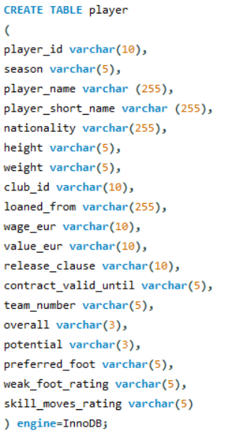
2.2.a construct tables
1.Create all the tables according to the schema.
Notice that all the attribute types are set to varchar temporarily to avoid importing error.
step_1_construct_tables.sql

Slide 15
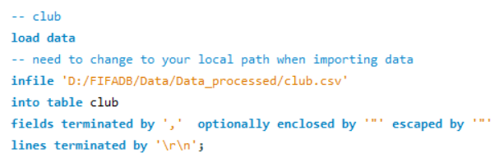
2.2.b import real data
2. Import processed data
All the data are real-world data
From FIFA official database.
The initial data has been processed by our python program and manual work.
1
step_2_import_data.sql

Slide 16
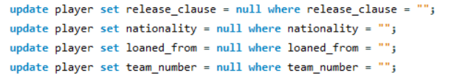
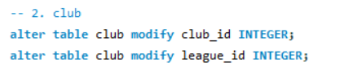
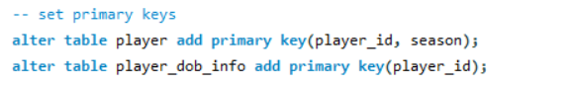

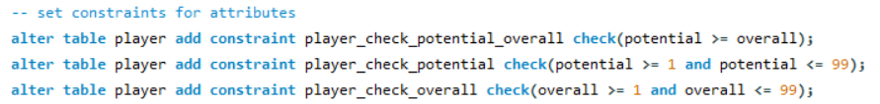
2.2.c set constraints
3. (1)Handle abnormal value
(2)transform attribute types
(3)set primary keys
(4)set foreign keys
(5)set constraints
(1)Handle abnormal value
(2)transform attribute types
(3)set primary keys
(4)set foreign keys
(5)set constraints
All codes are from step_3_set_constraints.sql

Slide 17
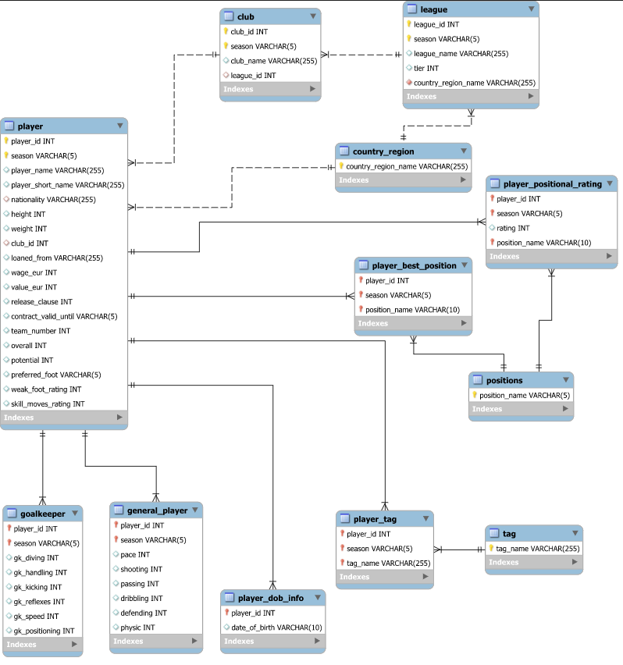
Final MySQL EERD:
(Generated from MySQL reverse engine)

Slide 18
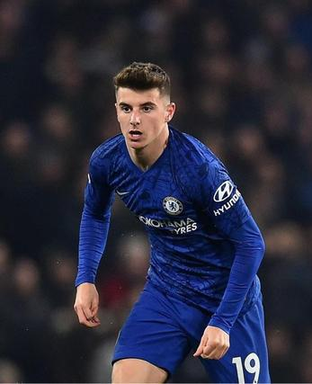
3. Database website
Website performing daily operation queries

Slide 19
3. Website
How to run the website:
1. "**pip install -r requirements.txt**”run this command for all package
2. In **config.py** to confige **mysql**'account and password
3. run **views.py**
4. ctrl + click on "**http://127.0.0.1:5000.**"

Slide 20
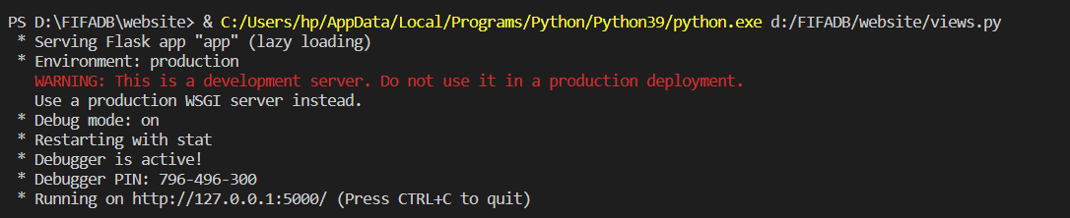
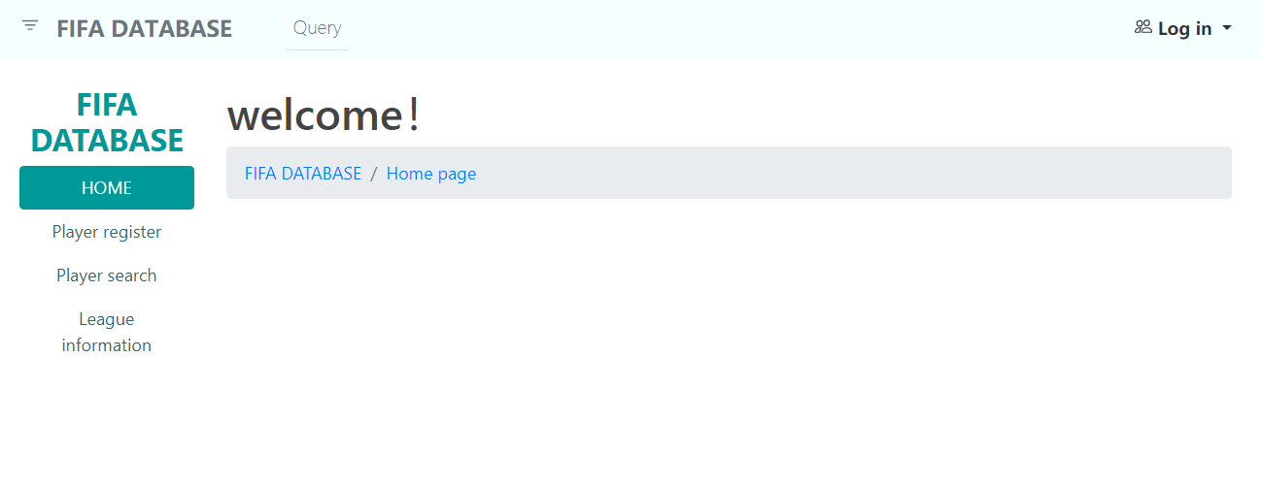
3. Website
1.
2.

Slide 21
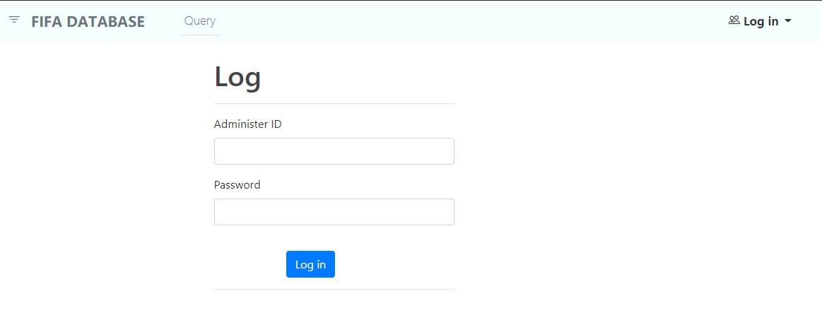
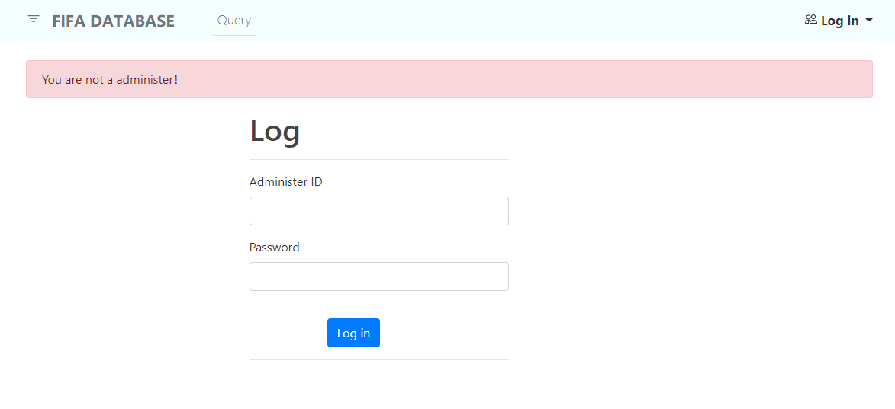
3. Website ---Log In
**You can log in to get more authority as a administer
**Otherwise you will be warn when you try to register a new player.

Slide 22
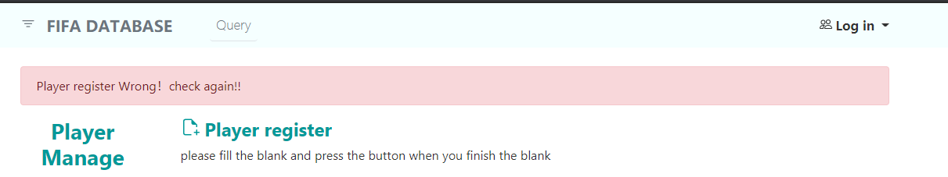
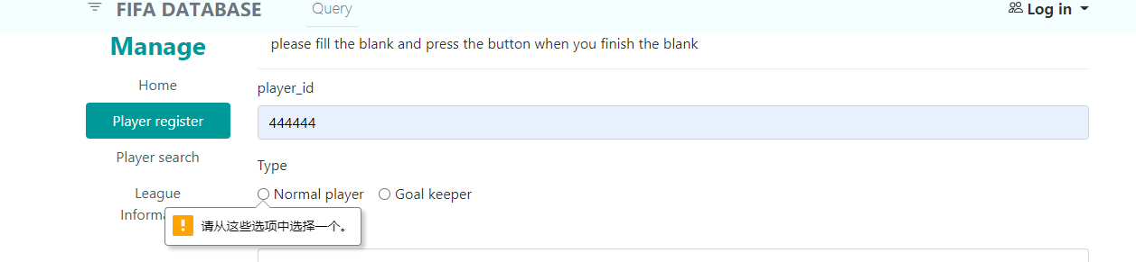
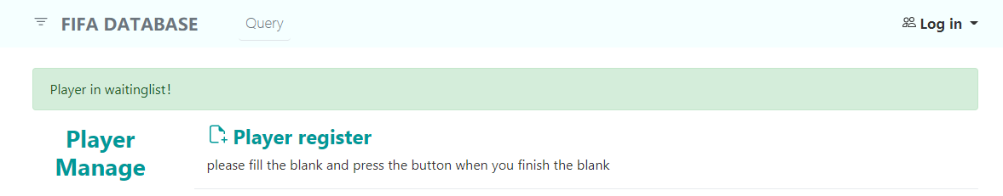
3. Website --New Player Register
The new player must have unique id and season,we will check it if you insert duplicate information
The new player must have all information otherwise we will warn you for that
Once the information complete, the new_player’s information will be stored in the waiting list for further confirm.

Slide 23
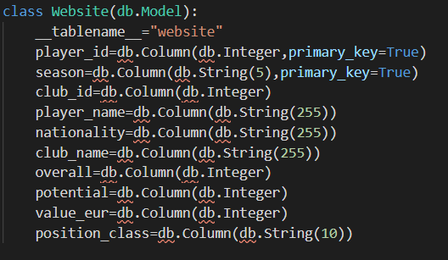
3. Website --Search Query
The search function is connected to the local MySQL database.

Slide 24
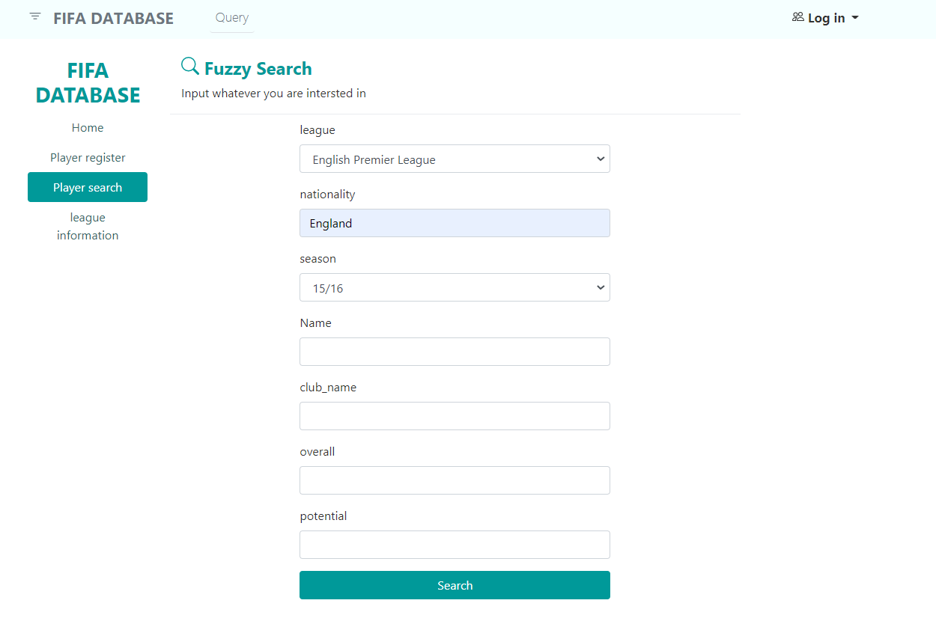
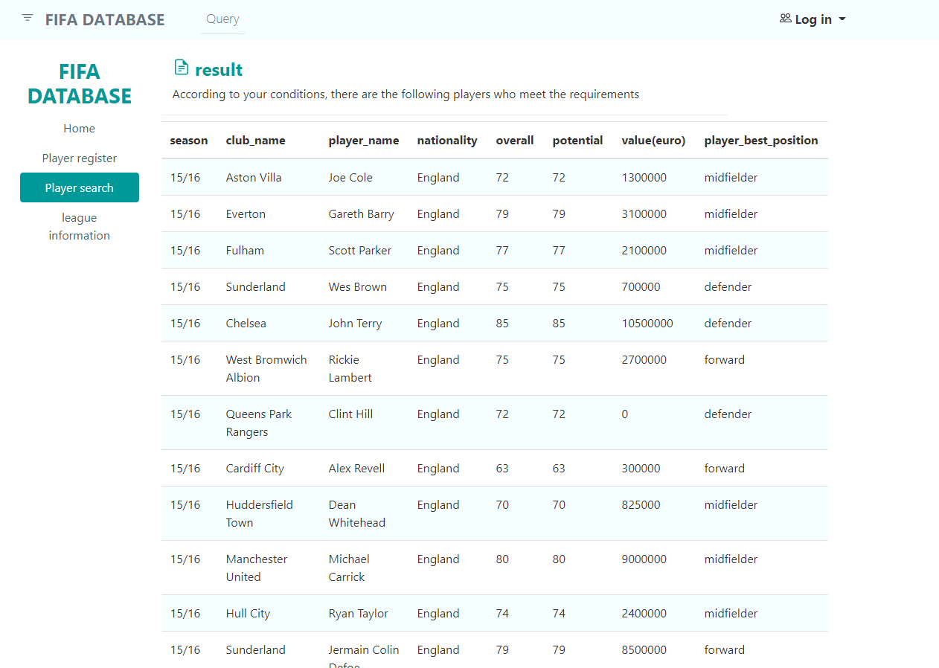
3. Website --Search Query

Slide 25
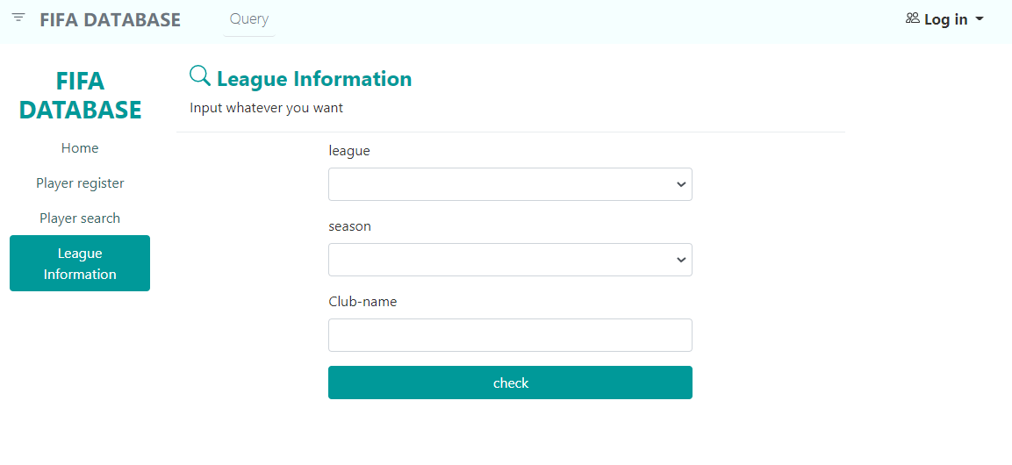
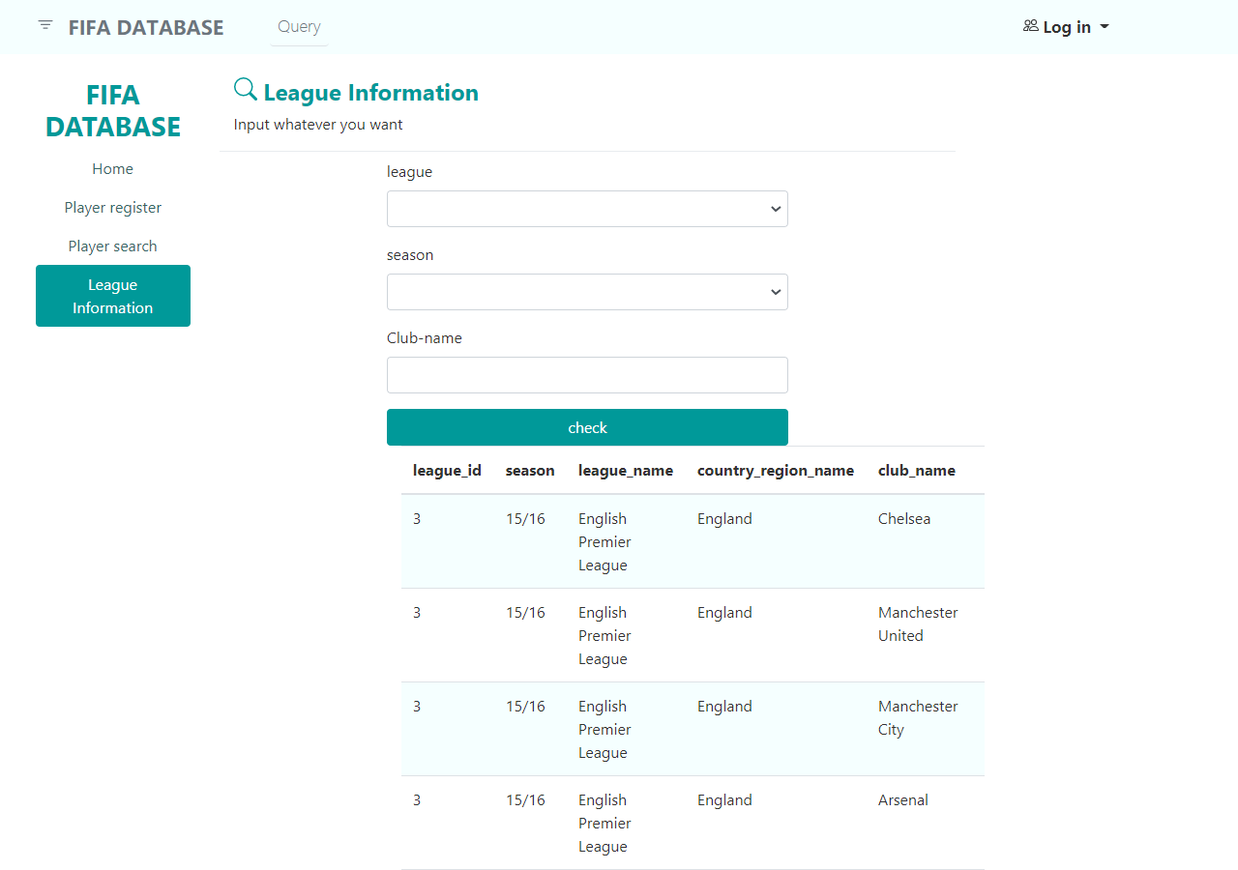
3. Website --League-Club Information

Slide 26

4 Data Analysis
4.1 How does the total salaries of the BIG 6 clubs of English Premiere League change from season 14/15 to 20/21?
4.2 The rank of clubs in each of the "Big Five" European football leagues in terms of total wage in season 20/21.
4.3 A Comparison of the Big 3 Clubs of La Liga in Terms of Overall Ratings of Different Positions from Season 18/19 to 20/21.

Slide 27
4.1 How does the total salaries of the BIG 6 clubs of English Premiere League change from season 14/15 to 20/21?
Generally,
Highest total wage:
Manchester City
Lowest total wage:
Tottenham Hotspur (14-18)
Arsenal (18-21)
16/17 to 19/20:
The total wage of Arsenal dropped significantly from about € 3.1m to 2m.
14/15 to 20/21:
Manchester City, Liverpool, and Tottenham Hotspur had an upward trend in total wage.

Slide 28
4.2 The rank of clubs in each of the "Big Five" European football leagues in terms of total wage in season 20/21.

Slide 29
4.2 The rank of clubs in each of the "Big Five" European football leagues in terms of total wage in season 20/21.

Slide 30
4.2 The rank of clubs in each of the "Big Five" European football leagues in terms of total wage in season 20/21.

Slide 31
4.2 The rank of clubs in each of the "Big Five" European football leagues in terms of total wage in season 20/21.

Slide 32
4.2 The rank of clubs in each of the "Big Five" European football leagues in terms of total wage in season 20/21.

Slide 33
4.2 The rank of clubs in each of the "Big Five" European football leagues in terms of total wage in season 20/21.

Slide 34
4.3 A Comparison of the Big 3 Clubs of La Liga in Terms of Overall Ratings of Different Positions from Season 18/19 to 20/21.
Read Madrid and FC Barcelona had close overall ratings, while Atlético Madrid had a lower overall rating.
In 19/20 and 20/21, Atlético Madrid’s ratings of defenders and midfielders were not far behind. However, its front line had a great disparity with the others.
The rating of defenders, midfielders and overall rating of Atlético Madrid showed an upward trend during the three seasons.

Slide 35
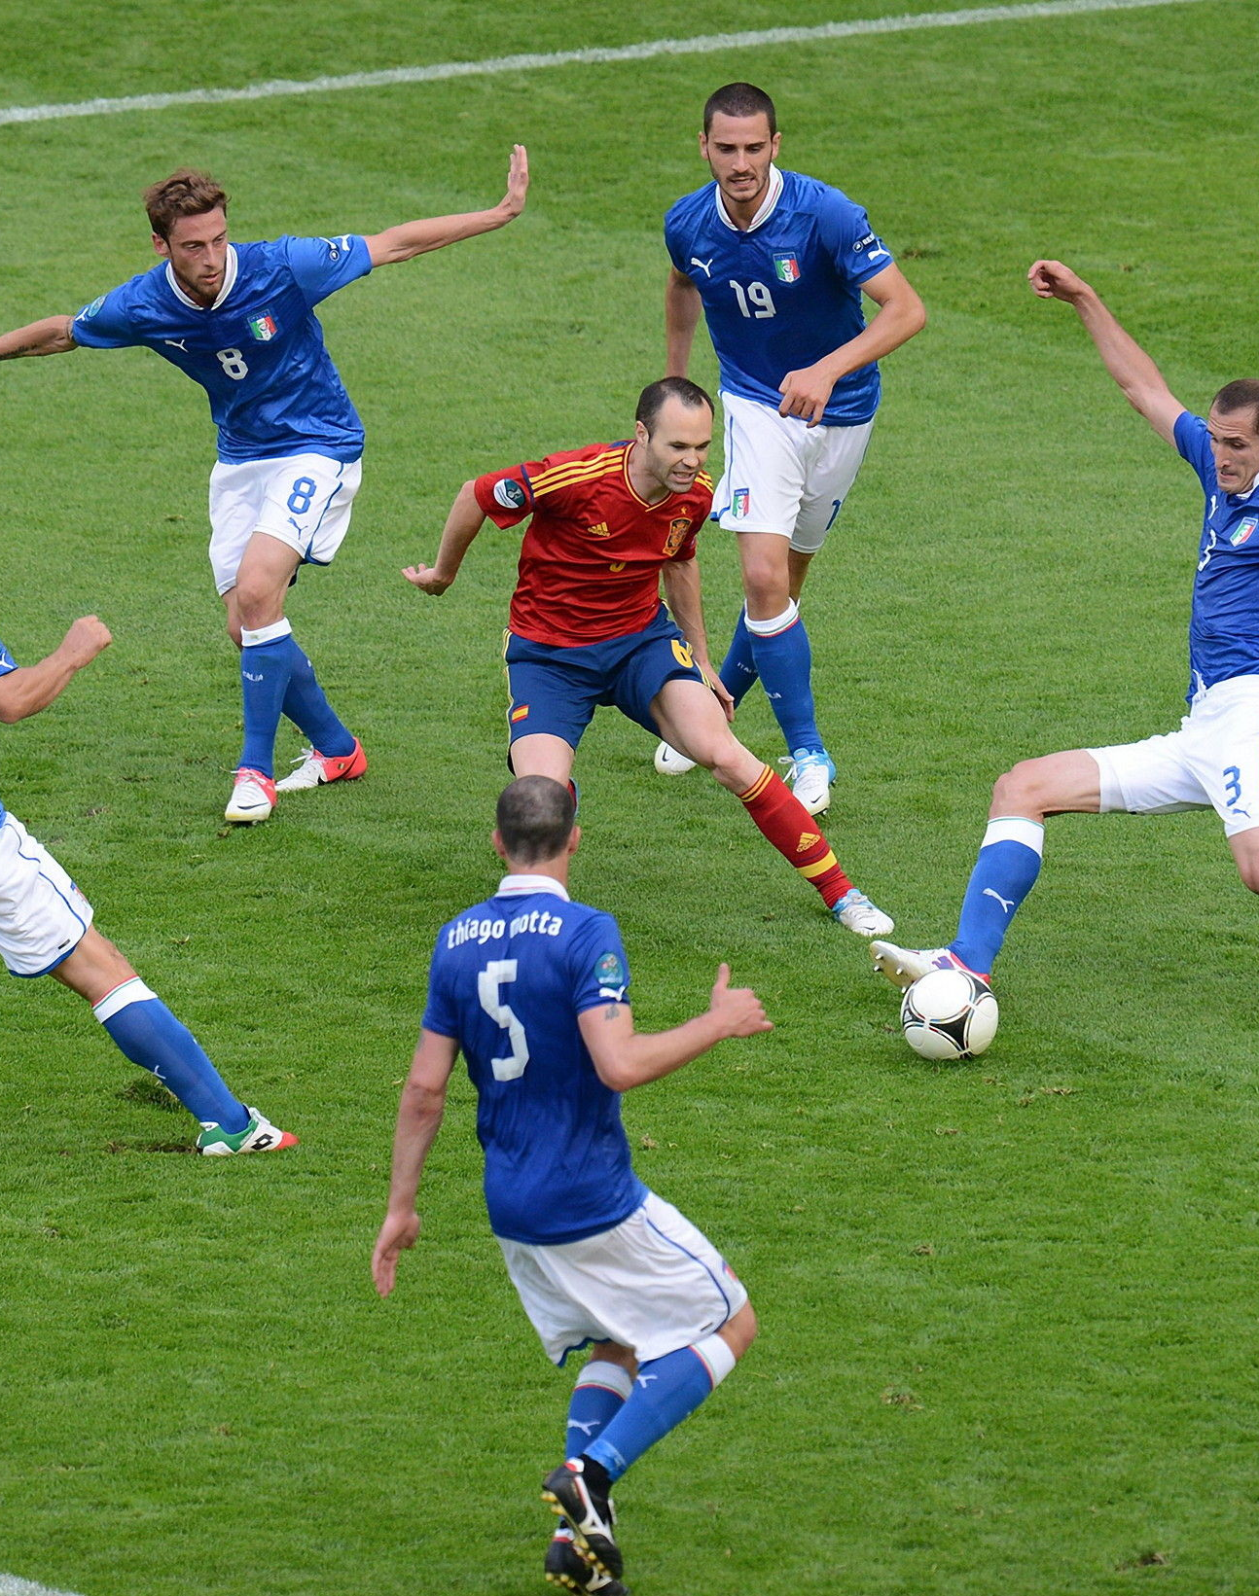
5. Create index on attributes
Decide indexes types on attributes
Implementation
Test sample

Slide 36
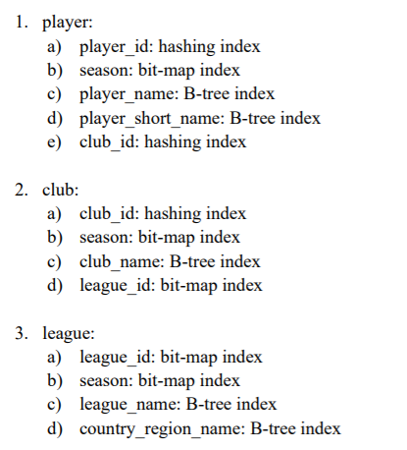
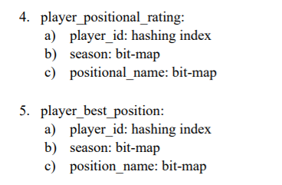
4.1 Decide index type
Set index on attributes on 5 frequently used tables

Slide 37
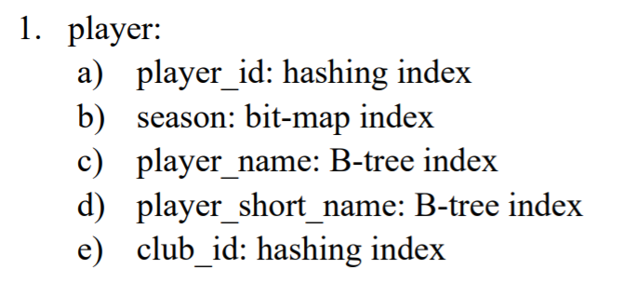
4.1 Decide index type
Explanation:

Slide 38
4.1 Decide index type
Explanation:
Huge number of ids: not suitable for bit-map
2. Prefix search: B-tree

Slide 39
4.1 Decide index type
Explanation:
Small number of season: storage sufficient with bit-map
2. Exact search: bit-map

Slide 40
4.1 Decide index type
Explanation:
Huge number of names: not suitable for bitmap
Distributes sparsely:
not suitable for bit-map
3. Prefix search: B-tree
structure

Slide 41
4.2 Implementation
MySQL does not support bit-map index:
change bit-map -> B-tree or hashing
Choose InnoDB to support foreign key mechanism:
InnoDB will set adaptive hash index automatically
Therefore, we just need to set indexes directly on default setting.

Slide 42

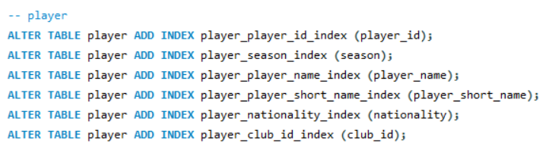
4.2 Implementation
Turn on InnoDB adaptive hash index
Create index on default setting

Slide 43
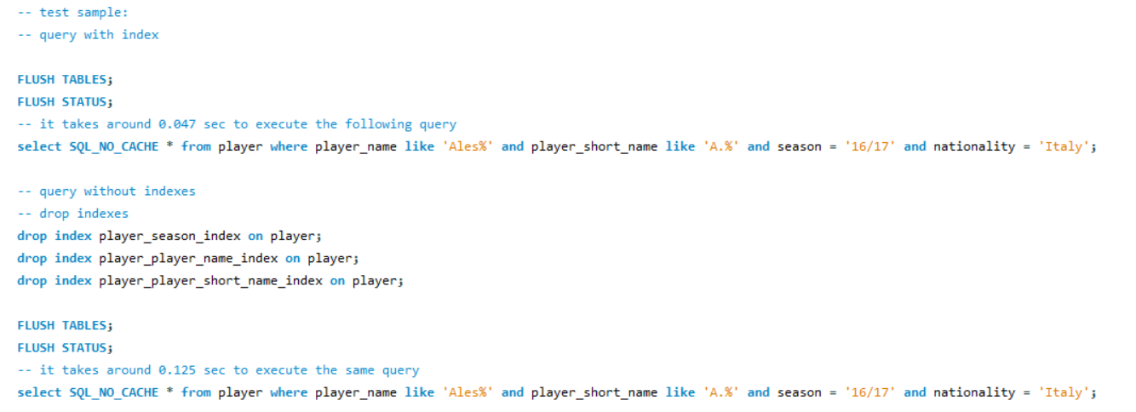
4.3 Test sample
Searching speed test: (test in MySQL)
1. Use FLUSH and SQL_NO_CACHE to avoid the search cache affect on testing
2. Deliberate put search query of indexes one before query without indexes

Slide 44
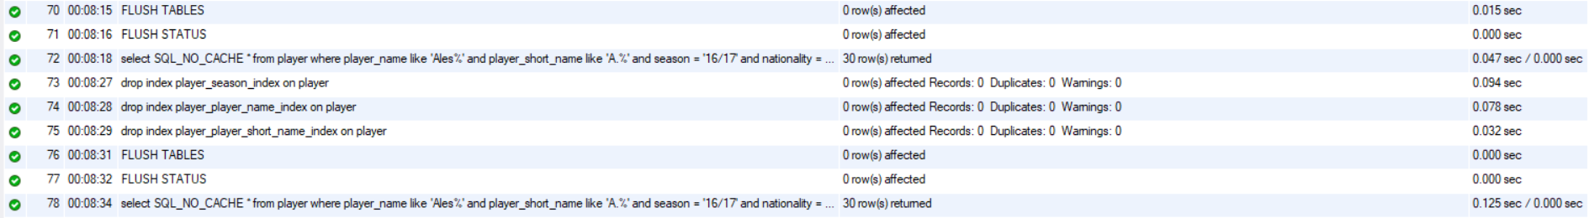
4.3 Test sample
Query result:
0.047 sec
0.125 sec
Search with index only use 0.047 sec comparing to 0.125 sec of query without indexes

Slide 45
Work assignments & distribution

Slide 46
References
1. Dataset is retrieved from https://www.kaggle.com/bryanb/fifa-player-stats-database.

Slide 47
Pictures:
Pictures:
https://www.google.com.hk/url?sa=i&url=https%3A%2F%2Fwww.redbull.com%2Fgb-en%2Ffifa-17-cover-stars-profiles&psig=AOvVaw2eTg02BIEAUjA-RdtlID9q&ust=1619192994838000&source=images&cd=vfe&ved=0CAIQjRxqFwoTCMiMq46akvACFQAAAAAdAAAAABAD
https://www.google.com.hk/url?sa=i&url=https%3A%2F%2Fwallpapercave.com%2Ffc-bayern-munich-uefa-champions-league-2020-wallpapers&psig=AOvVaw0qdaCl4d_hoH-HHbC1zl5t&ust=1619192879646000&source=images&cd=vfe&ved=0CAIQjRxqFwoTCLi5p9iZkvACFQAAAAAdAAAAABAD
https://www.google.com.hk/url?sa=i&url=https%3A%2F%2Fen.wikipedia.org%2Fwiki%2FFile%3ALuzhniki_Stadium%2C_2018_FIFA_World_Cup.jpg&psig=AOvVaw0I_4Fu_VD4IEuFEKHV3srn&ust=1619193244341000&source=images&cd=vfe&ved=0CAIQjRxqFwoTCJC2xYmbkvACFQAAAAAdAAAAABAD
https://www.google.com.hk/url?sa=i&url=https%3A%2F%2Fwww.fifa.com%2Fworldcup%2Fnews%2F2006--how-artem-dzyubas-dreams-came-true-w475-2962919&psig=AOvVaw00w1pkDc2HLYeUgW6X8gBP&ust=1619193411304000&source=images&cd=vfe&ved=0CAIQjRxqFwoTCLCc2dybkvACFQAAAAAdAAAAABAD
https://gimg2.baidu.com/image_search/src=http%3A%2F%2Fwww.csisc.com.cn%2Fd%2Fpicture%2F2019%2F06%2F23%2F0ee13f2e04164d3.jpg&refer=http%3A%2F%2Fwww.csisc.com.cn&app=2002&size=f9999,10000&q=a80&n=0&g=0n&fmt=jpeg?sec=1621699220&t=c636141142615786744bbc3419bf8d01
https://gimg2.baidu.com/image_search/src=http%3A%2F%2Foss.suning.com%2Fsnsis%2Fchannel_content%2Fos0aBSR3MyyLm1q8r1GUj2xxRp6wW4QxvvcXY19q07_D7vTyfULmYNWuVT9_p2ZD.jpg&refer=http%3A%2F%2Foss.suning.com&app=2002&size=f9999,10000&q=a80&n=0&g=0n&fmt=jpeg?sec=1621699353&t=c09a90583d906d788bb5ad6ea35310c6

